Slide 1
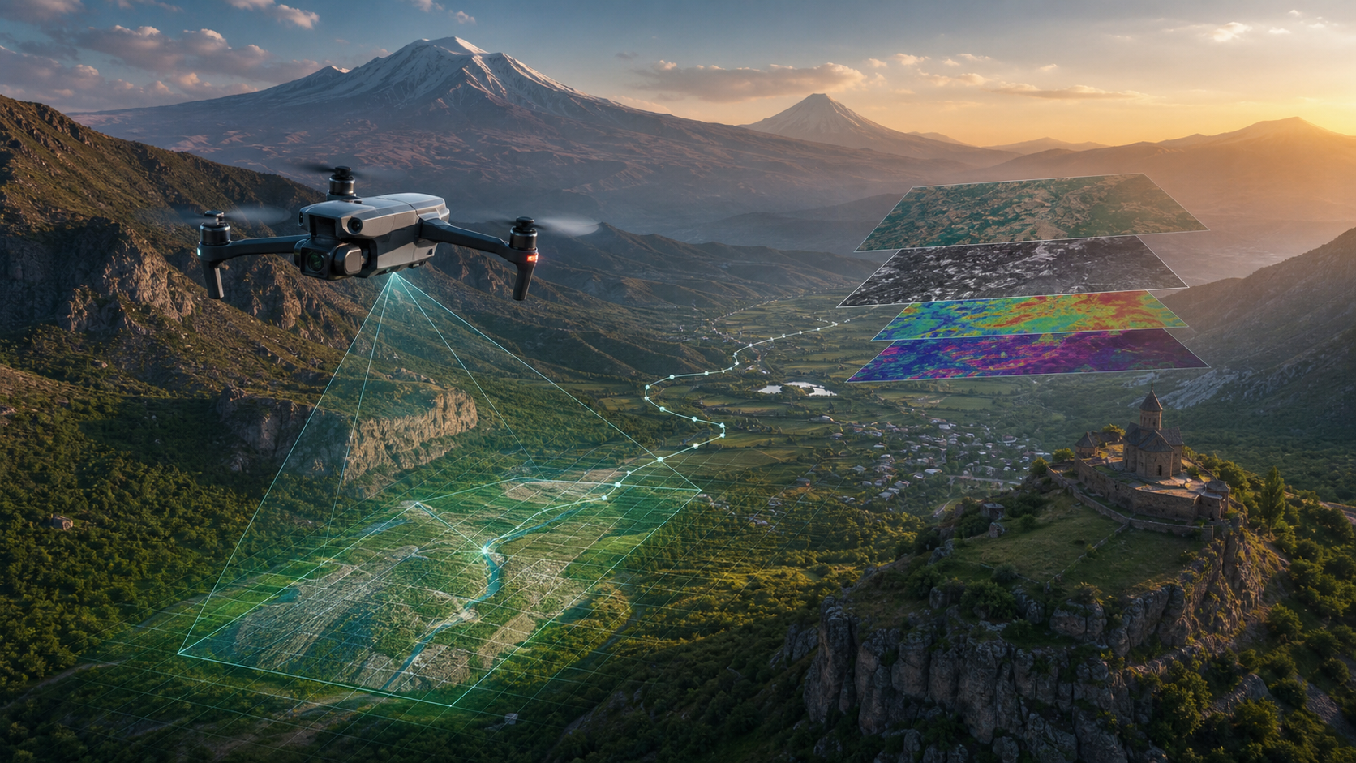
Տեսողական-Լեզվական Հիմնարար Մոդելներ
Օդային Ռոբոտաշինության Համար
ՀԱԿՈԲ ԹԱՄԱԶՅԱՆ – ԵՊՀ, Երևանէն
Դիլիջան · 2026

Slide 2





THE MISSION
What we want an aerial robot to do
MISSION SCENARIO
Fly to the north, pass the river and look for a bear. Wait until a bear appears on the field, track him as long as he gets hidden inside the forest. Fly back.
Understand
Perceive
Navigate
Decide
Parse a natural-language mission with multiple steps and constraints.
Fuse RGB, multispectral, thermal and SAR observations from drones and satellites.
Plan and execute a long-horizon flight through 3D space.
Detect, track, and act on objects of interest with safety guarantees.
24RL · Vision-Language Foundation Models for Aerial Robotics · Dilijan 2026

Slide 3



PROJECT
Four research pillars, one goal
PROJECT ANNOTATION
Develop a foundation system that lets aerial robots understand natural-language missions, perceive multi-spectral imagery and navigate autonomously
P1
P2
Foundation Vision Models
Vision-Language Navigation
Self-supervised pretraining for multi-band aerial imagery. Backbone for classification, segmentation, change detection, tracking.
Compact VLMs fine-tuned to follow text instructions in 3D urban environments.
P3
P4
Advanced VLN Scenarios
Aerial Dataset Collection
Long-horizon, history-aware navigation; generalization to new phrasings and visual modalities.
Real-world flights drone + curated 100 M-scale aerial corpora.
24RL · Vision-Language Foundation Models for Aerial Robotics · Dilijan 2026

Slide 4




01 · PROJECT
4 Research pillars
THE GAP
Aerial data is exploding,
labels are not.
PART 1
PART 2
Foundation Vision Models
Vision-Language Navigation
Self-supervised pretraining for multi-band aerial imagery.
Drones that follow natural language instructions.
New satellites, new spectral bands, and new drones come online every year. Hand-labeling for every sensor and city is impossible.
PART 3
PART 4
Advanced VLN Scenarios
Dataset Creation
Our answer: self-supervised, multi-band, language-grounded foundation models.
Long-horizon, history-aware urban UAV navigation.
New aerial corpora collected over Armenia.
24RL · Vision-Language Foundation Models for Aerial Robotics
2

Slide 5

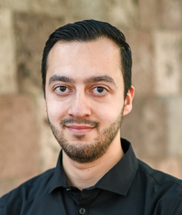


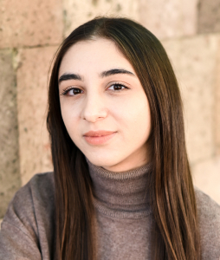
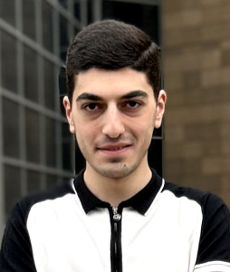
Our Team
PI
CI
RESEARCHER
RESEARCHER
RESEARCHER
RESEARCHER
Naira Hovakimyan
Hakob Tamazyan
Ani Vanyan
Alvard Barseghyan
Anna Khosrovyan
Narek Nurijanyan
UIUC · AVIATE Center
YSU · YerevaNN · PhD, Math Logic
YerevaNN · YSU
YerevaNN · YSU
YerevaNN · YSU
YerevaNN · YSU
24RL · Vision-Language Foundation Models for Aerial Robotics · Dilijan 2026

Slide 6
STATE TODAY
Where the four pillars stand today
ACTIVE
ACTIVE
ACTIVE
PLANNED
PART 1
PART 2
PART 3
PART 4
Foundation Vision
VLN Models
Advanced VLN
Dataset Collection
GeoCrossBench (ICLR'26)
χViT pretraining
Scaling-laws (NeurIPS'26)
Map-in-Pixel design
Qwen3-VL fine-tuning
History-aware UAV nav.
14.1 % SR on CityNav (ECCV'26)
ROG-X drone arriving
Armenian aerial corpus
24RL · Vision-Language Foundation Models for Aerial Robotics · Dilijan 2026

Slide 7
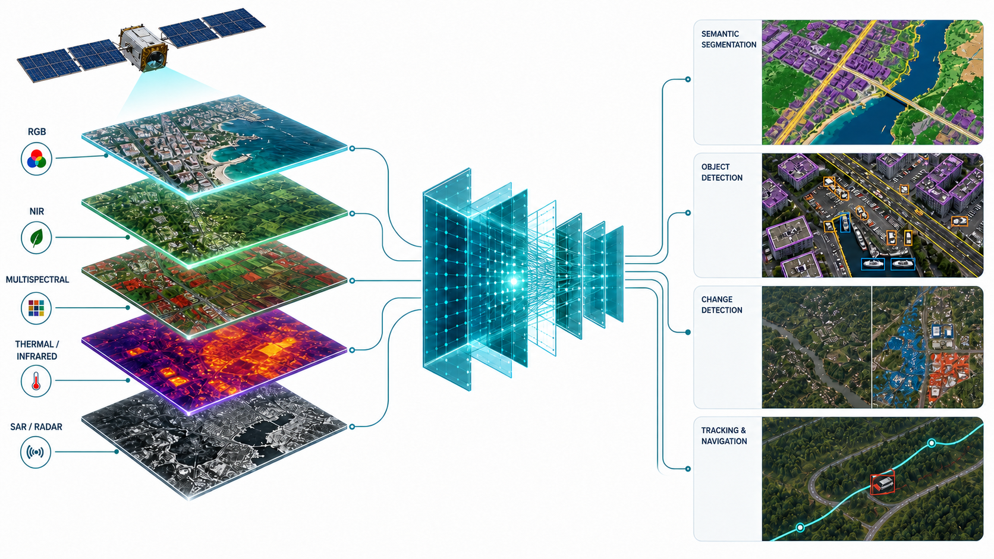
P1 — FOUNDATION VISION MODELS
Aerial data is fundamentally multi-band
The Challenge
13+ bands per satellite
Sentinel-2 alone has 13 spectral bands; Sentinel-1 SAR adds polarimetric channels.
Few labels per band
Labelled corpora cover only a tiny slice of all (sensor × band × geography) combinations.
Models stop generalizing
Backbones pretrained on RGB collapse when test bands differ — even for the same scene.
Our position
Self-supervised, channel-aware foundation models can break this barrier.
RGB · NIR · Multispectral · Thermal · SAR → one foundation model for four downstream tasks.
24RL · Vision-Language Foundation Models for Aerial Robotics · Dilijan 2026

Slide 8
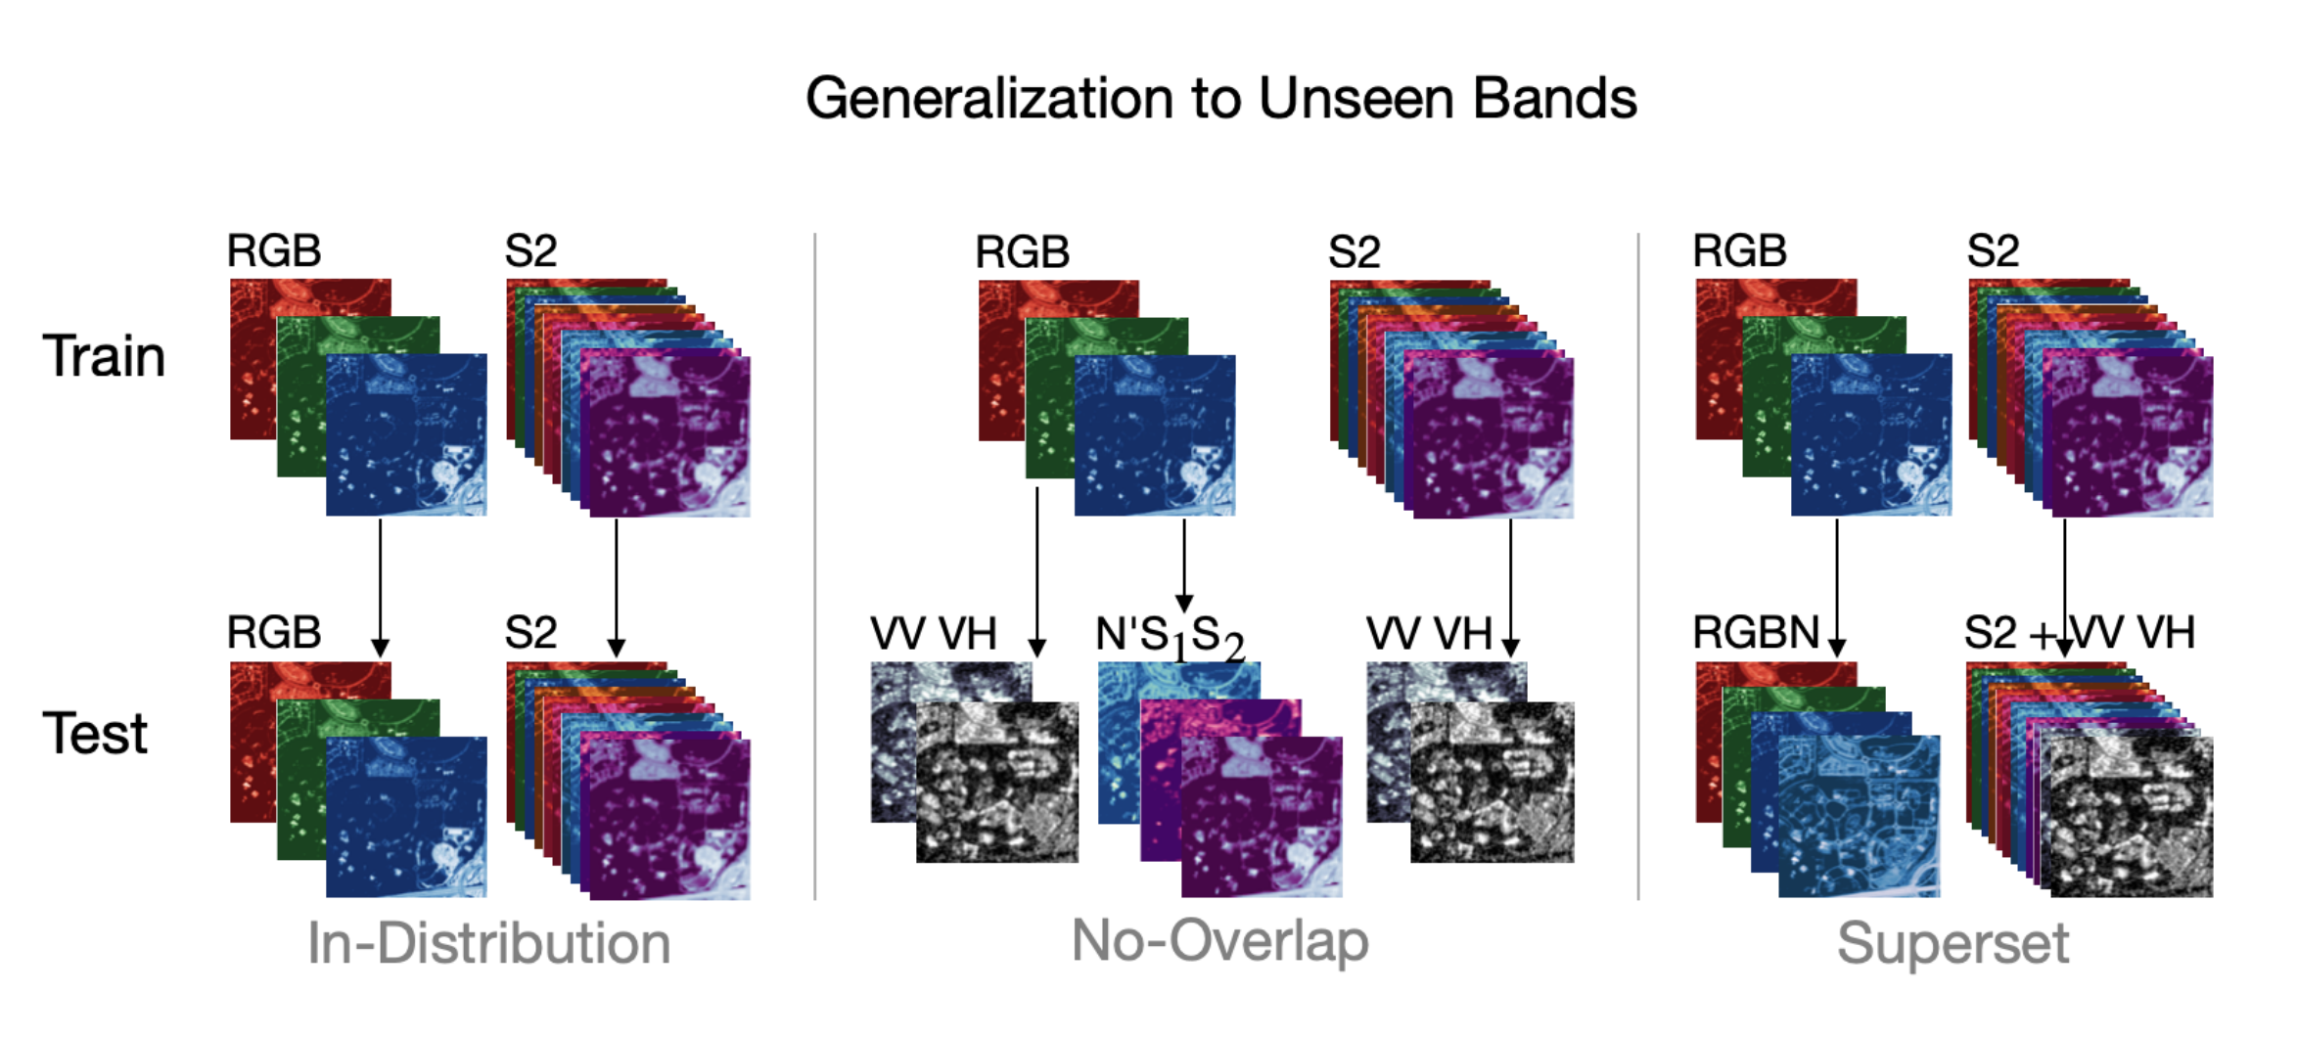

P 1 — GEOCROSSBENC
Benchmarking cross-band generalization
What we measure
1 · IN-DISTRIBUTION
Train and test on the same bands.
Baseline transfer — the comfort zone.
2 · NO-OVERLAP
Train on RGB, test on SAR or N'S2.
How well do models bridge to different sensors?
3 · SUPERSET
Three evaluation protocols measure cross-satellite transfer.
Train on RGB, test on RGB + extra bands.
Can models exploit additional bands at test time?
8 datasets · 3 tasks · 10+ foundation models compared · first benchmark with frozen-backbone evaluation across non-overlapping spectral bands.
24RL · Vision-Language Foundation Models for Aerial Robotics · Dilijan 2026

Slide 9
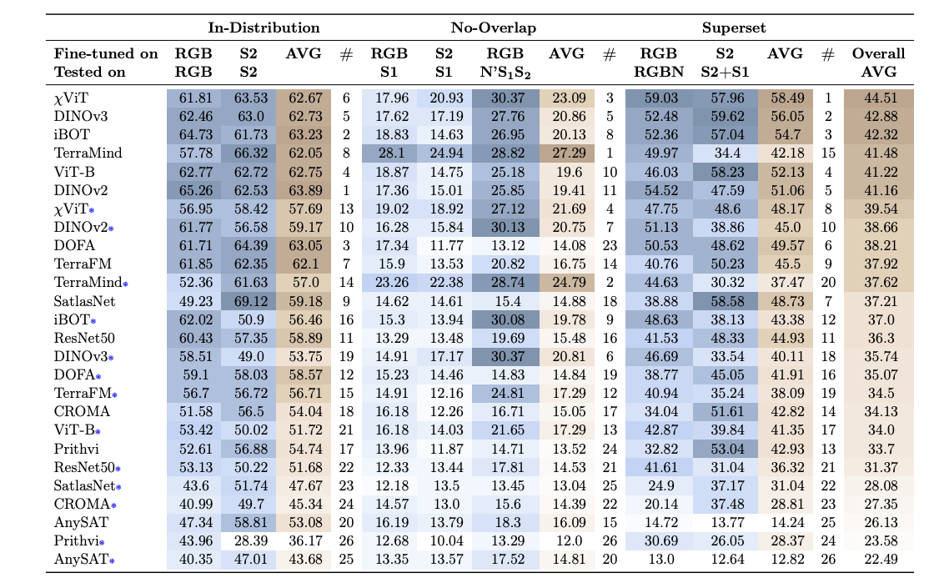

P 1 — RESULTS
Even the best foundation models struggle to transfer
2-4×
performance drop
when training and test bands
do not overlap
5-25%
drop on average
when extra bands are
available at test time
DINOv3
general-purpose model
beats RS foundation models
in-distribution
Our model wins on transfer
χViT (our model)
Channel-based iBOT pretraining: significantly outperforms DINOv3, Prithvi, SatMAE, Clay and other RS foundation models in the no-overlap and superset settings.
Code & datasets is released openly.
24RL · Vision-Language Foundation Models for Aerial Robotics · Dilijan 2026

Slide 10
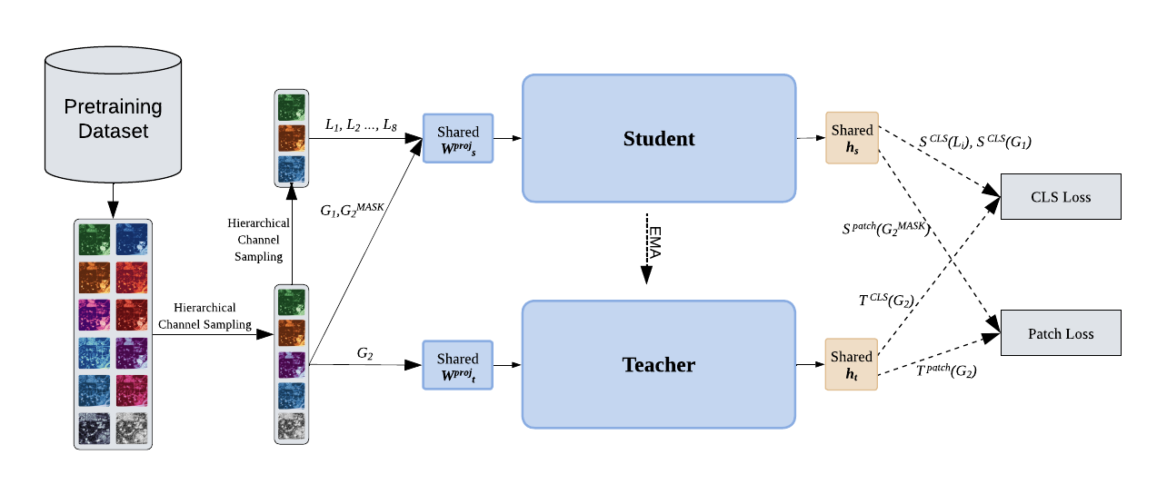
P 1 — CHIVIT ARCHITECTURE
Channel-aware self-distillation for any sensor
IDEA 1
Hierarchical channel sampling
Random subsets of bands per training step → forces band-agnostic features.
IDEA 2
Parallel S1+S2 data
Up-weighting co-registered SAR + optical pairs is the strongest "translation" signal.
IDEA 3
Self-distillation (iBOT)
EMA teacher with patch-level + CLS-level losses — no human labels required.
χViT — Channel-based iBOT pretraining with Hierarchical Channel Sampling.
Pretraining: 23 M aerial images (Satlas + MillionAID + BigEarthNet + Sen12MS + Intelinair) · ViT-B · 400 M sample exposures · 12 days × 8 H100s
24RL · Vision-Language Foundation Models for Aerial Robotics · Dilijan 2026

Slide 11
P 1 — χViT RESULTS
Overall ranking of best models
Overall ranking (avg across all settings)
χViT (ours)
44.51
DINOv3 (Meta)
42.88
iBOT (ByteDance)
42.32
TerraMind (IBM)
41.48
ViT-B
41.22
DOFA
38.21
24RL · Vision-Language Foundation Models for Aerial Robotics · Dilijan 2026

Slide 12
P1 — SCALING LAWS
Scaling laws for image self-distillation
Compute-equal comparison (Maxar)
THE QUESTION
+3 pp
When data is highly redundant, is more unique data always better than more repetitions?
Baseline
Lower
THE ANSWER
On Maxar imagery, repeating just 1.5% of the corpus beats training on the full 51.2 M images — under the same compute budget.
Full 51.2M
unique images
Curated 1.5%
repeated
ImageNet behavior
(traditional)
New scaling law disentangles unique-sample count and repetition density.
Figures: average k-NN downstream accuracy under fixed compute budget.
24RL · Vision-Language Foundation Models for Aerial Robotics · Dilijan 2026

Slide 13
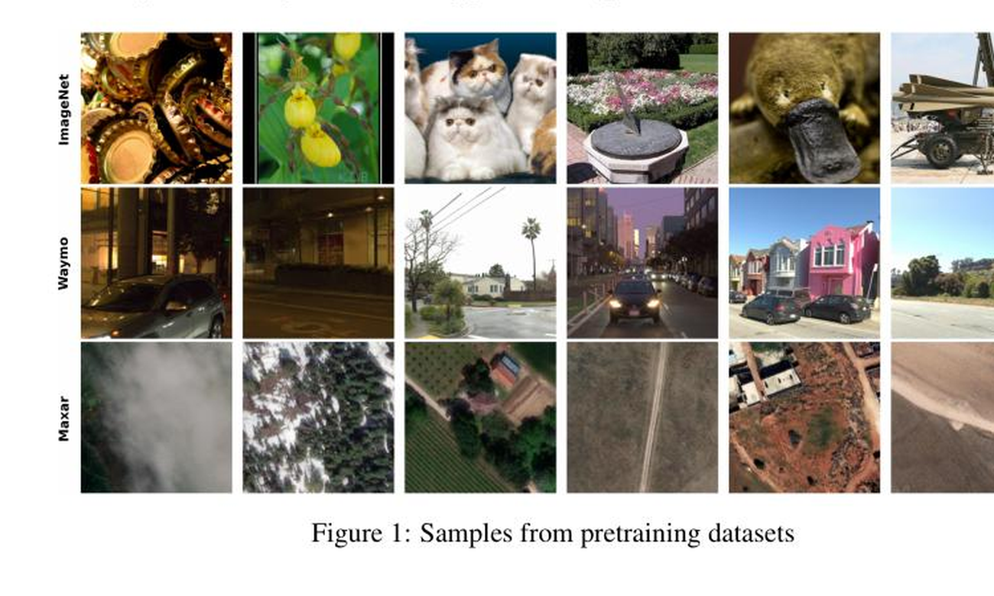
P1 · DATASETS WE STUDIED
Three corpora · three redundancy regimes
IMAGENET
1.28 M images
Curated, category-balanced, no near-duplicates.
Classical: more unique data still helps.
WAYMO
5.8 M frames
Driving sequences, modest scene diversity.
Repetition-tolerant: subsets ≈ full data.
MAXAR
51.2 M tiles
Satellite imagery, extreme redundancy.
Redundancy-dominated: 1.5 % subset wins.
Scaling-laws Figure 1 — random samples from ImageNet, Waymo and Maxar pretraining corpora.
Hypothesis: redundancy structure of a visual corpus changes the answer to "is more unique data better?"
24RL · Vision-Language Foundation Models for Aerial Robotics · Dilijan 2026

Slide 14
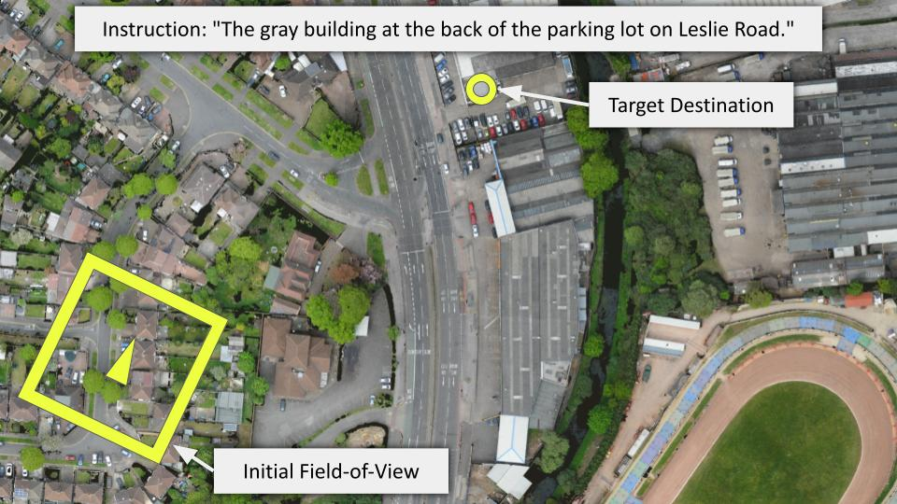
P 2-3 — VISION-LANGUAGE NAVIGATION
Natural language instruction following drones
Why aerial VLN is hard
Landmark blindness
Targets are rarely visible from the start position.
Long horizons
240 actions on average per trajectory.
3D motion
Forward / turn / ascend / descend / stop.
CityNav: instruction-conditioned UAV navigation in real urban scenes (Cambridge, Birmingham).
Baseline CityNav success rate: 6.4 % · Our target: more than double it.
24RL · Vision-Language Foundation Models for Aerial Robotics · Dilijan 2026

Slide 15
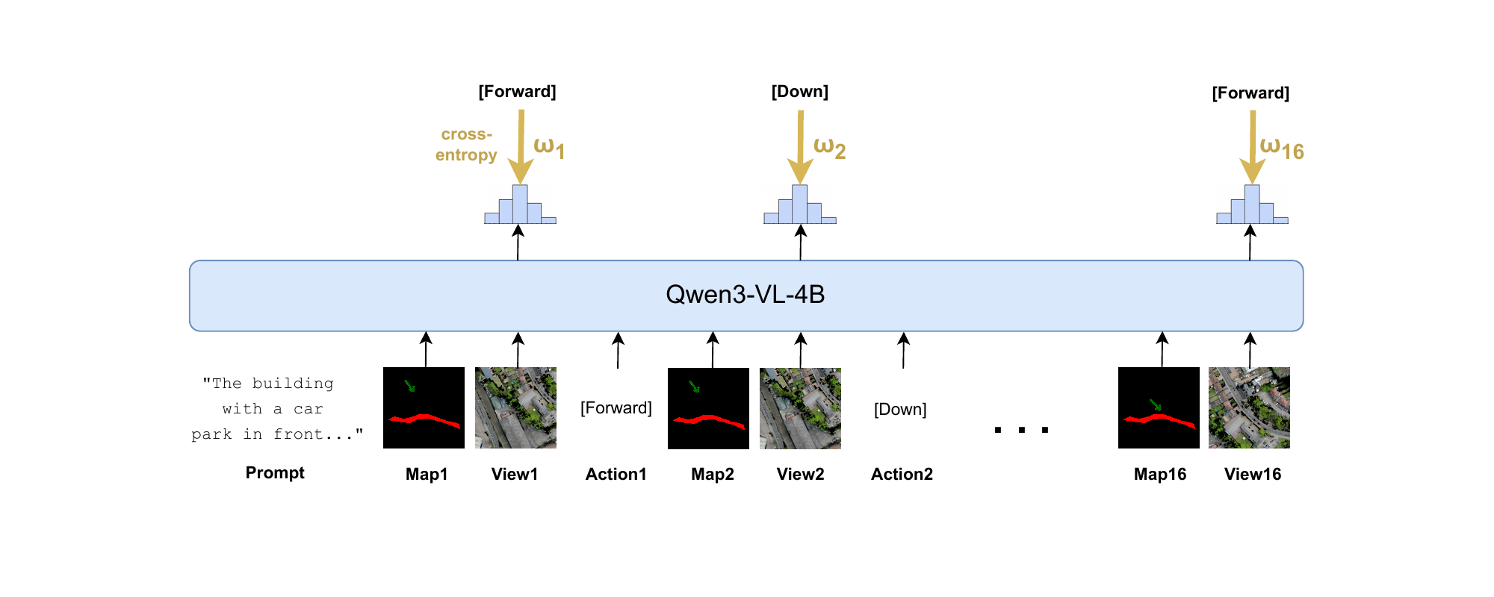
P3 · METHOD
Map-in-Pixel + history-aware fine-tuning of compact VLMs
C1
Map-in-Pixel
C2
History-aware loss
Render the global landmark map as an image — same vision encoder as the egocentric view.
Last-token-only / linearly-weighted CE puts the gradient on the actually-executed action.
24RL · Vision-Language Foundation Models for Aerial Robotics · Dilijan 2026

Slide 16
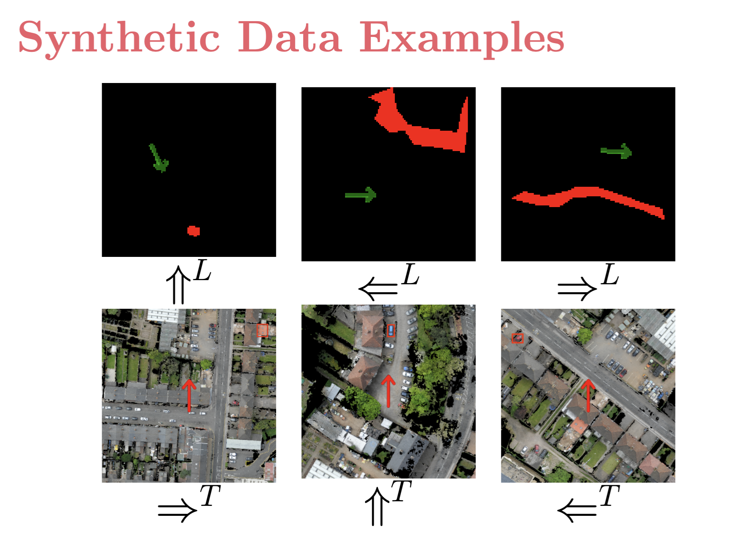
P3 — RESULTS
From 6.4 % to 14.1 % success rate on CityNav unseen
Synthetic skill-focused trajectories
CITYNAV TEST UNSEEN · SUCCESS RATE
CityNav baseline
6.4 %
Qwen3-VL-4B fine-tuned
10.5 %
+ History + Map-in-Pixel
14.1 %
More than doubles the public CityNav baseline.
Geometry-driven C1–C6 templates teach alignment & STOP behaviors.
Architecture-agnostic gains: consistent improvements across Qwen3-VL-2B, Qwen3-VL-4B, Isaac-0.1-2B and Isaac-0.2-2B.
24RL · Vision-Language Foundation Models for Aerial Robotics · Dilijan 2026

Slide 17

P3· CROSS-MODEL ROBUSTNESS
Architecture-agnostic gains across compact VLMs
Test Unseen — Success Rate by base model
BEST
14.13 %
12.54 %
11.39 %
10.61 %
6.38 %
NE 80.9
NE 81.8
NE 86.4
NE 87.7
NE 93.8
Qwen3-VL-4B
Qwen3-VL-2B
Isaac-0.1-2B
Isaac-0.2-2B
CityNav baseline
TAKEAWAY
Gains are not Qwen-specific. Every architecture we tried (Qwen3-VL 2B / 4B, Isaac 0.1 / 0.2) beats the baseline. The recipe is the win, not the backbone.
24RL · Vision-Language Foundation Models for Aerial Robotics · Dilijan 2026

Slide 18
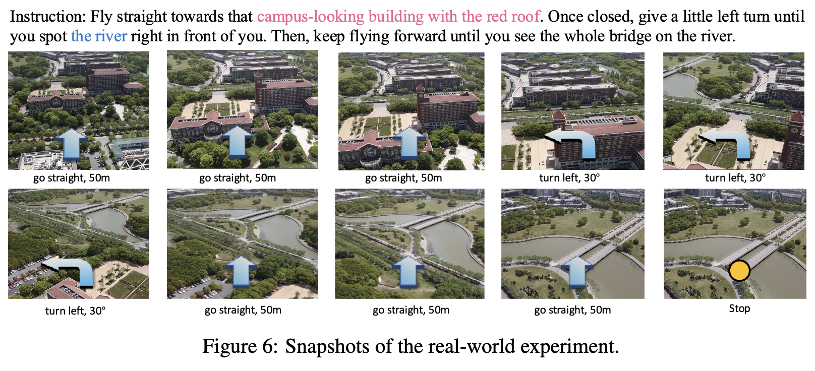
P4 — UPCOMING WORK
Building an Armenia-specific aerial corpus
Inspiration: OpenFly-style trajectory + instruction grounding, adapted to local landscapes.
24RL · Vision-Language Foundation Models for Aerial Robotics · Dilijan 2026

Slide 19
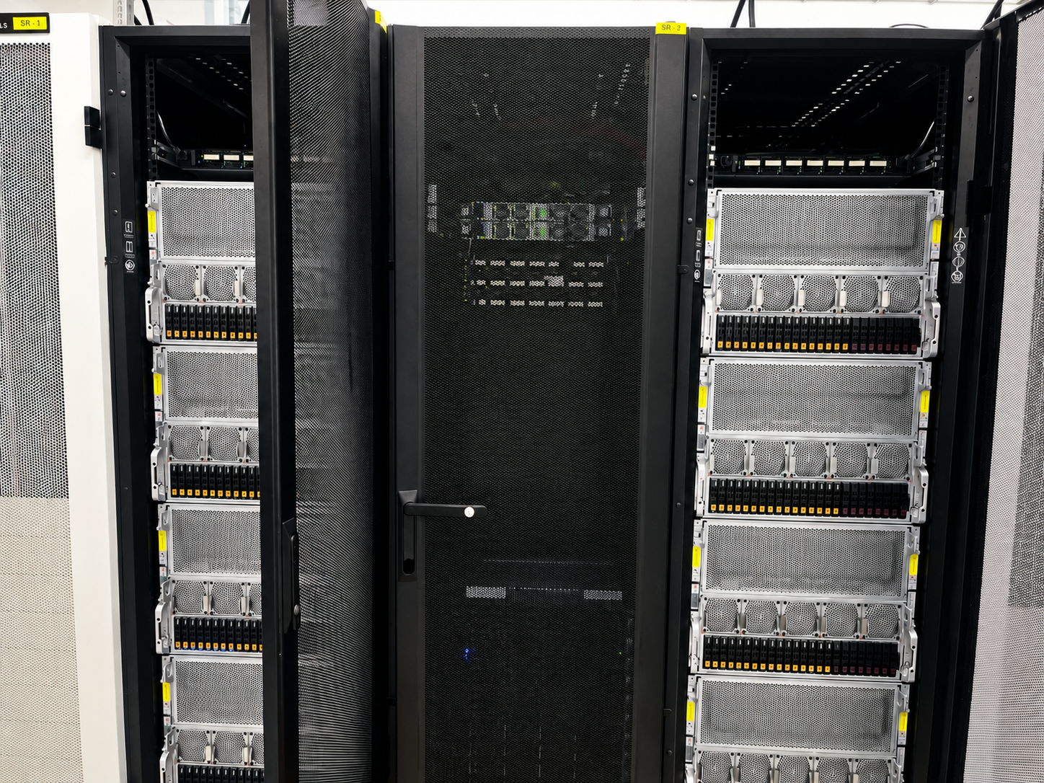
INFRASTRUCTURE
Compute that backs the work — YSU's GPU lab
In-house GPU compute
64 × H100
Workhorse for χViT pretraining and VLM fine-tuning.
DGX A100:
8× A100 80GB
DGX H100:
8× H100 80GB
Nebius.ai
Located at YSU
Located at YSU
Donated 8xH100
for scaling experiments
24RL · Vision-Language Foundation Models for Aerial Robotics · Dilijan 2026

Slide 20
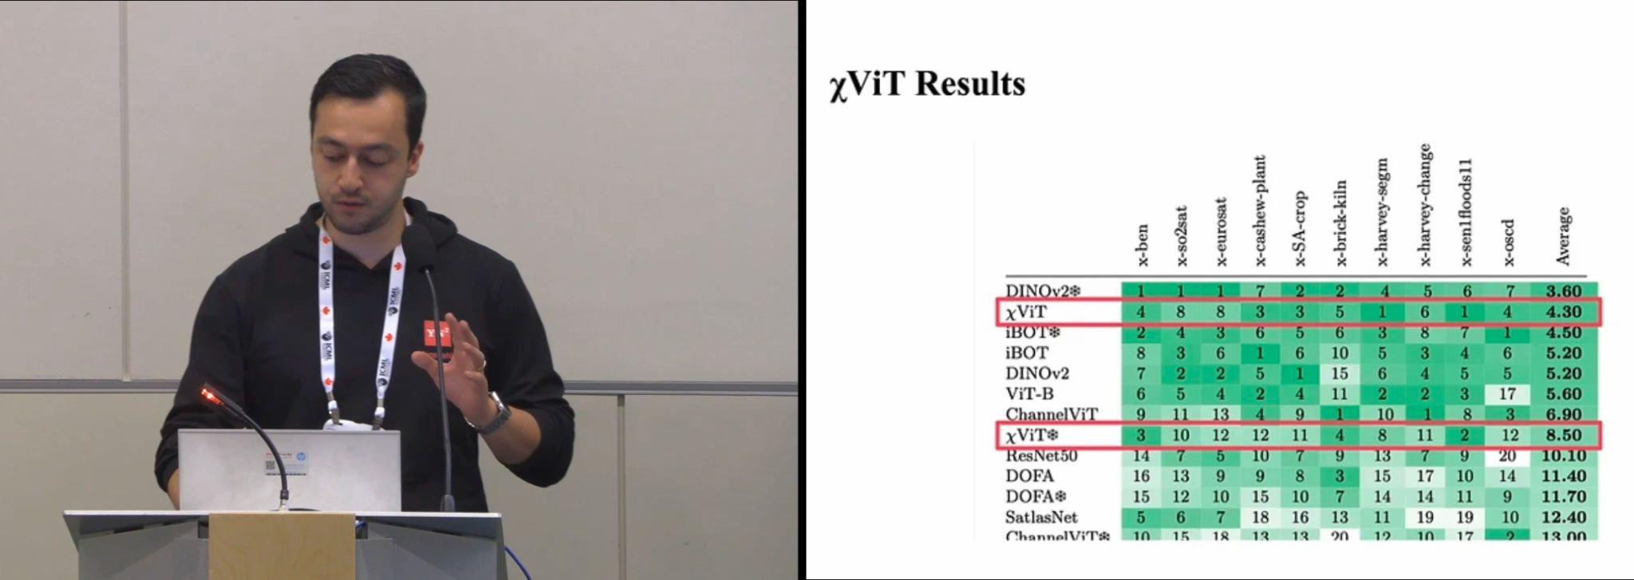
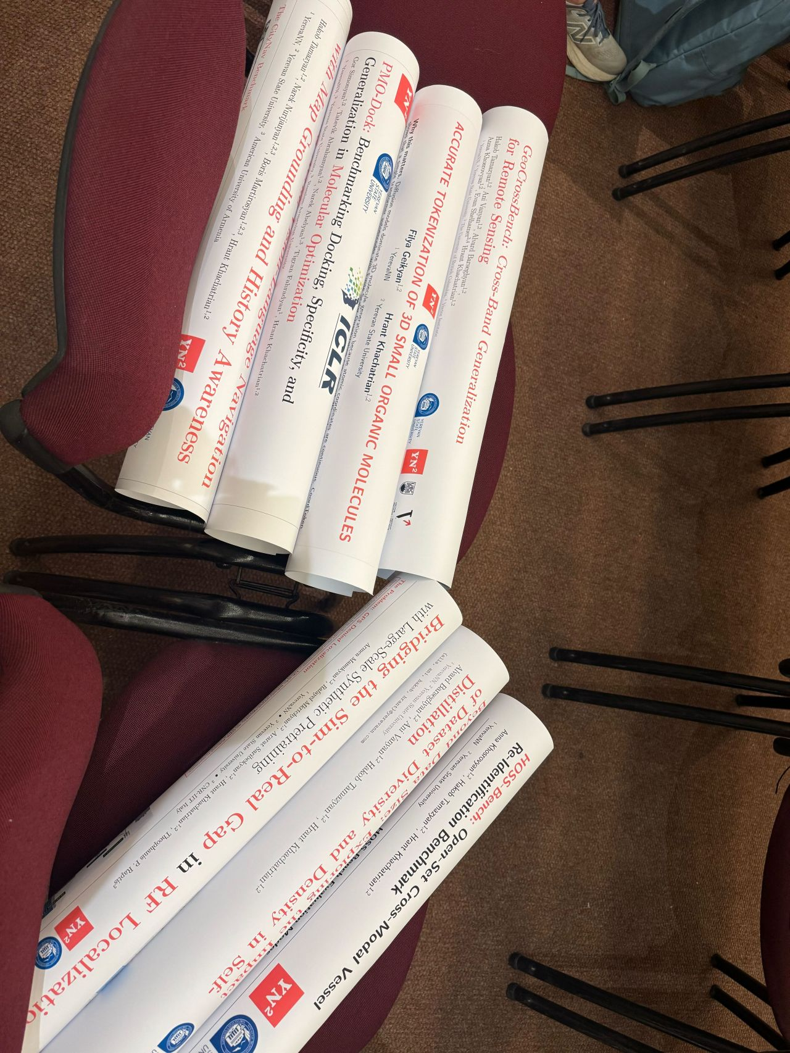
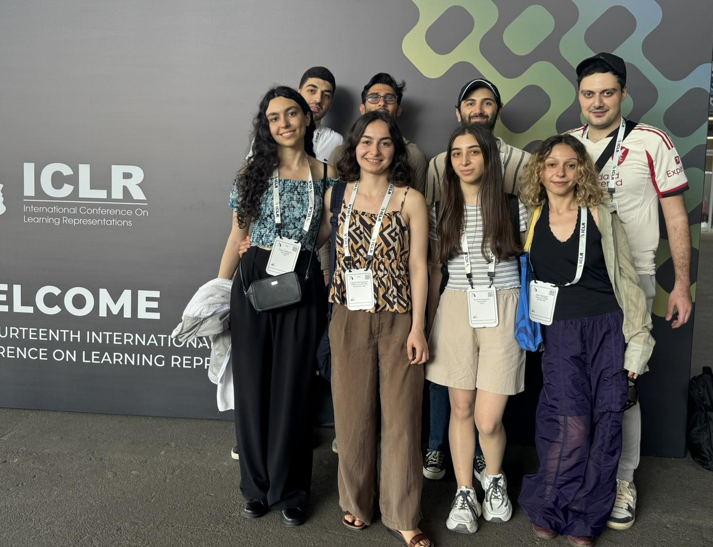
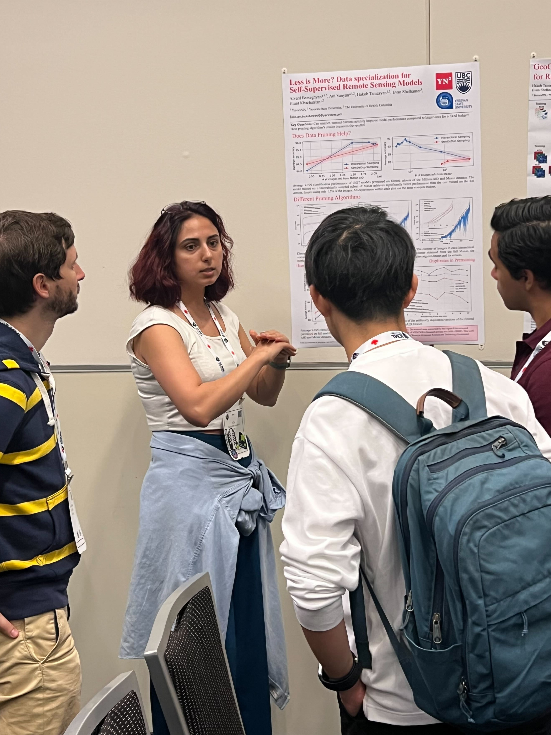
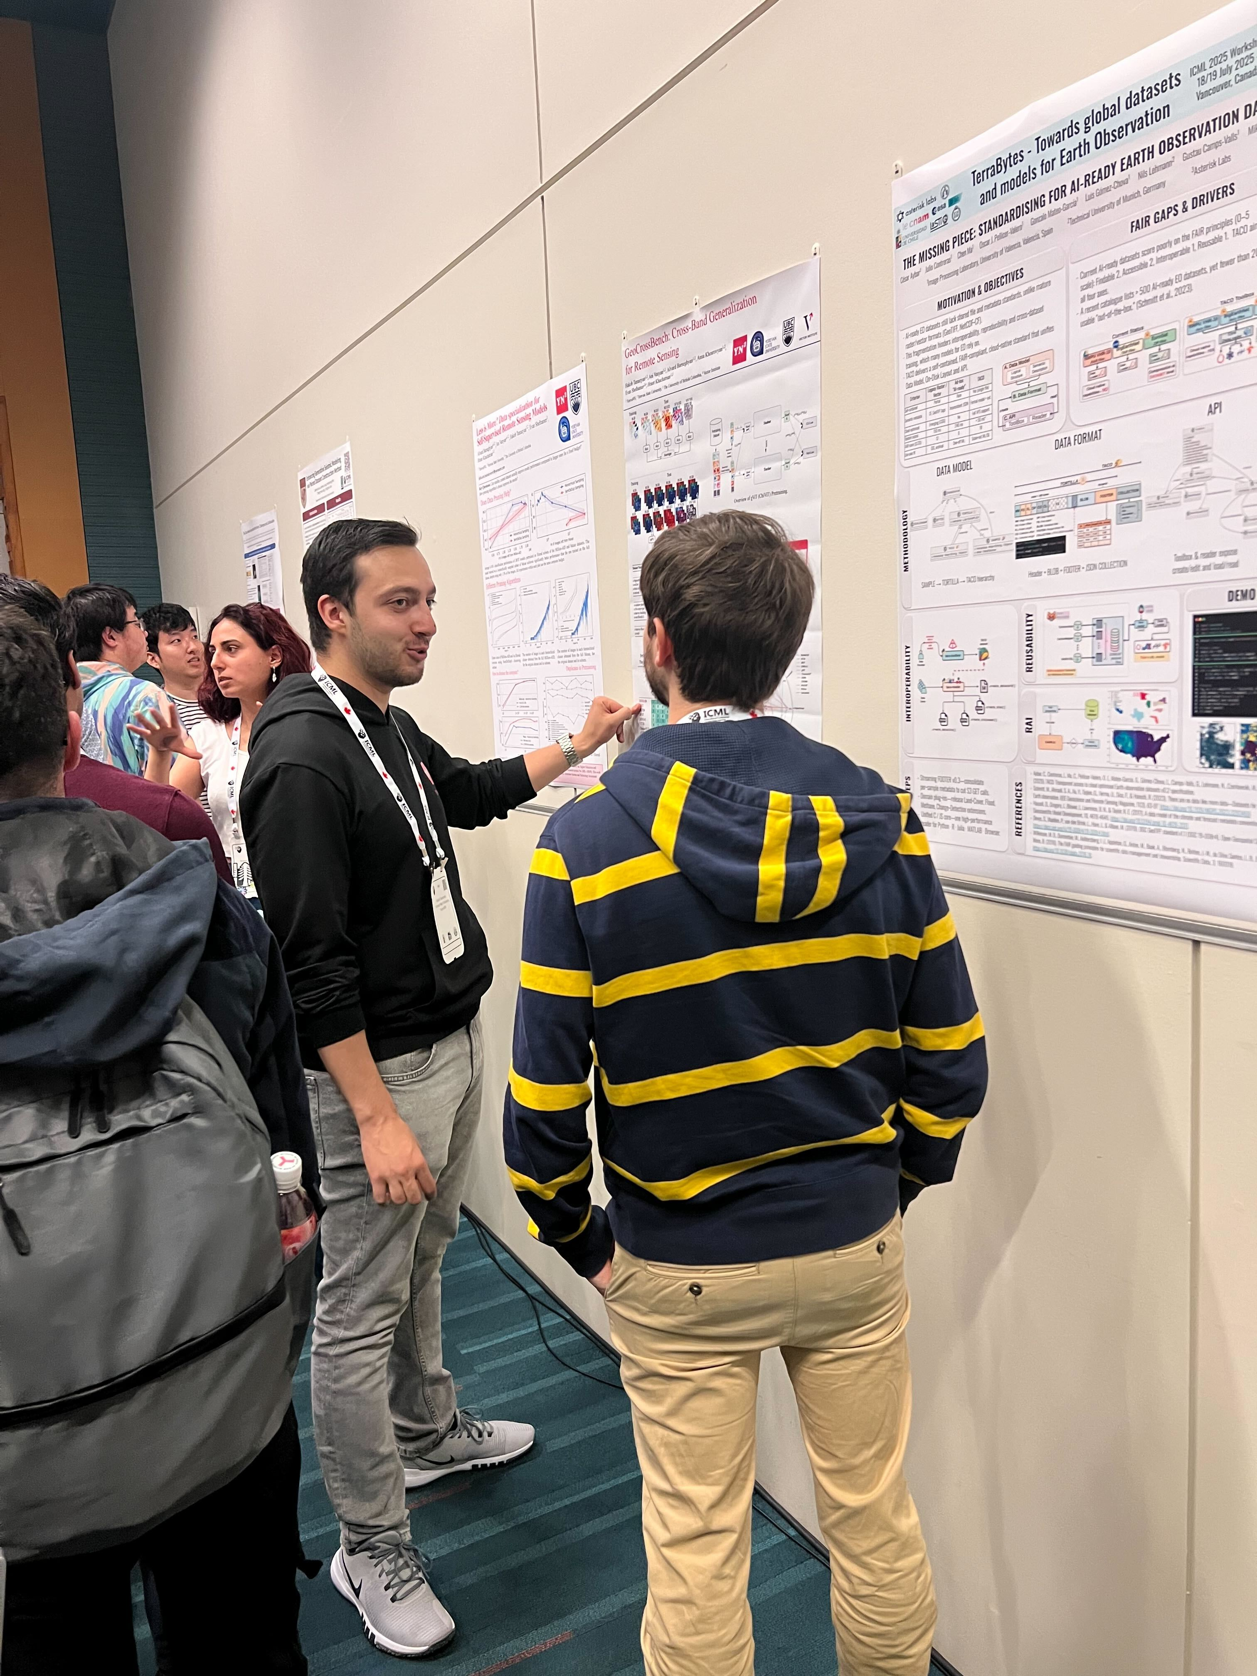
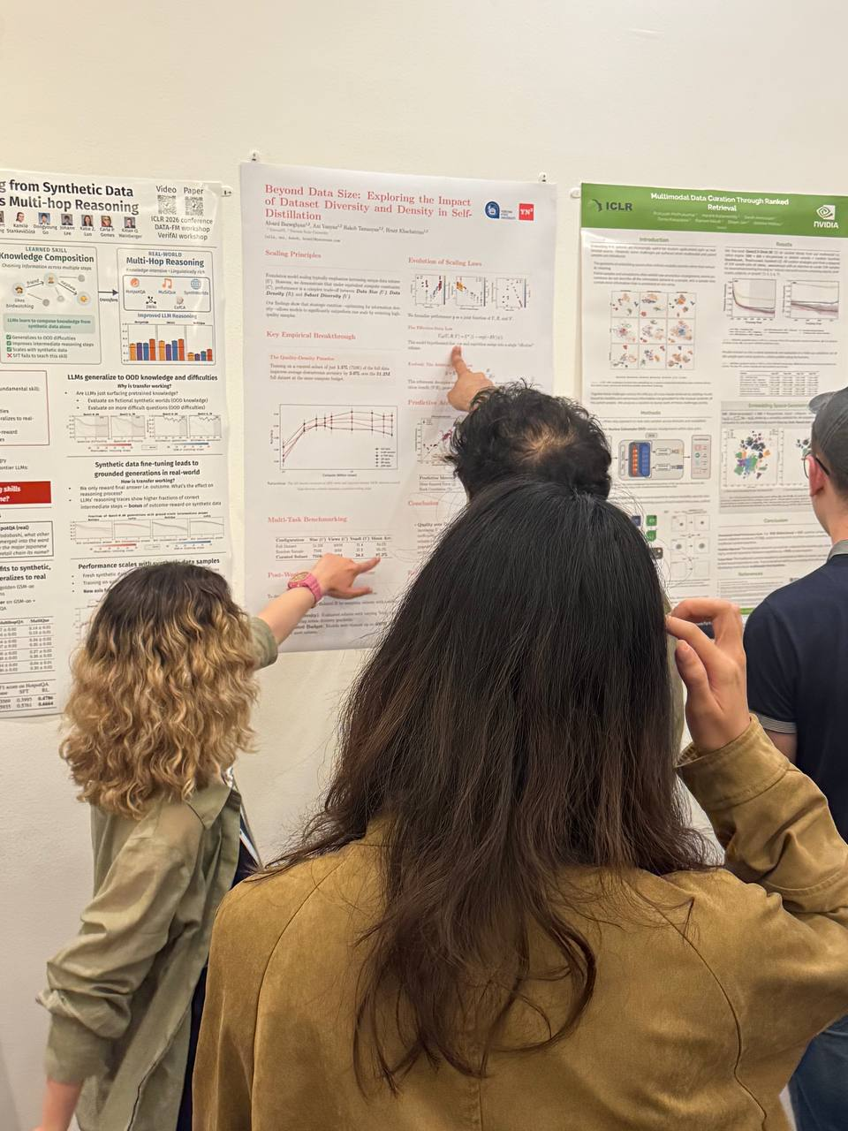
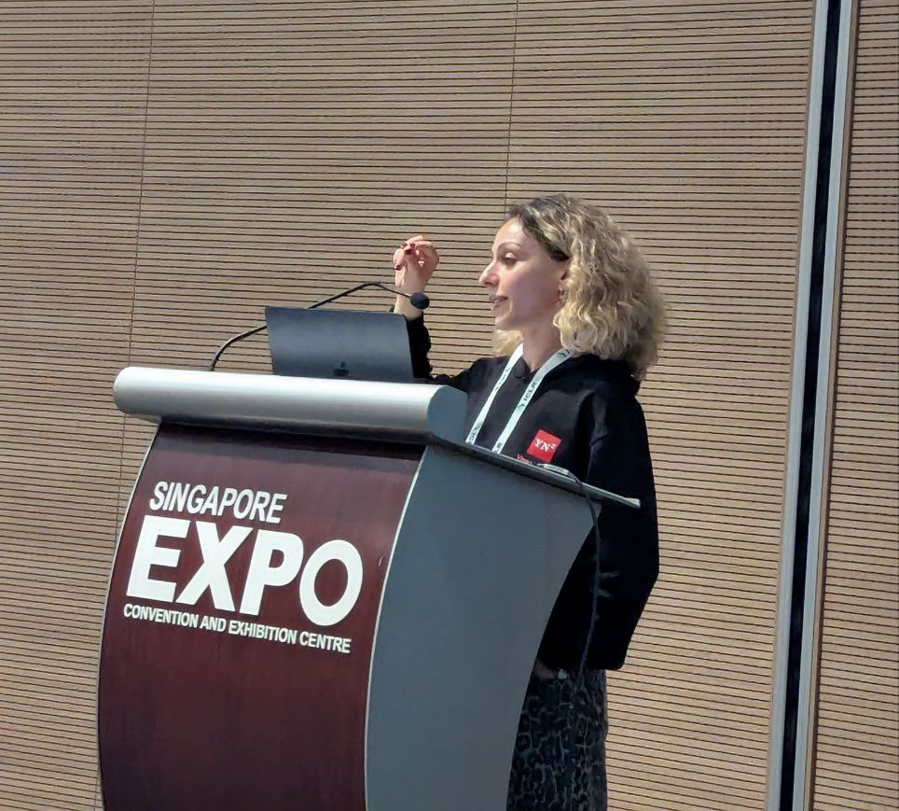


Slide 21


13 · OUTPUTS
Publications, talks, and what comes next
Project | Topic | Venue / status | Year
GeoCrossBench | Cross-band generalization benchmark + χViT model | ICLR · under review | 2026
Map-in-Pixel UAV VLN | History-aware fine-tuning, Qwen3-VL on CityNav | ECCV · under review | 2026
Self-Distillation Scaling Law | Repetition vs unique samples in vision SSL | NeurIPS · under review | 2026
Armenia aerial dataset | Collected with ROG-X drone, multi-band + VLN | Planned | 2026-27
Talks & dissemination
Researcher training
ARPI 2024 (Yerevan) · Dilijan 2026 progress report
Joint work shared with UIUC AVIATE Center group meetings
Open release planned: code, datasets, model weights
Two early-career researchers (Anna, Narek) onboarded onto the project
PhD-level supervision via UIUC PI + YSU CI
Long visits planned to UIUC for the next academic year
24RL · Vision-Language Foundation Models for Aerial Robotics

Slide 22
Շնորհակալություն
24RL · Vision-Language Foundation Models for Aerial Robotics · Dilijan 2026

